Slide 2
RECAP..
Signals (IMPULSE, STEP, RAMP, PARABOLIC) (1, A/s, A/s², A/s³)
Type & Order of systems
I & II order systems
Transient response analysis
Characteristics equation

Slide 3
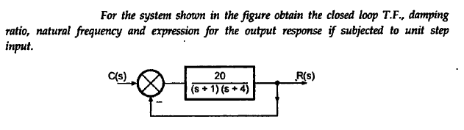

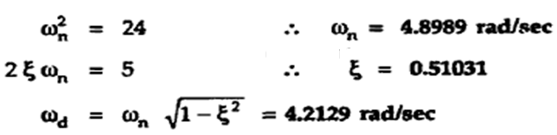
RECAP..

Slide 4

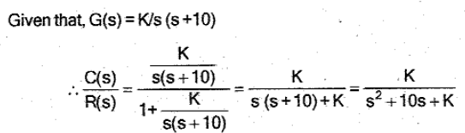

Problems in Time Response Analysis
Write the CLTF of the system.

Slide 5
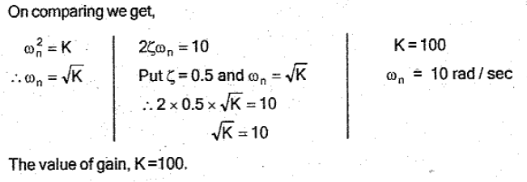
Problems in Time Response Analysis

Slide 6
STEADY STATE ANALYSIS

Slide 7
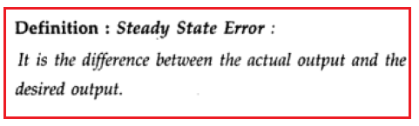
The occurrence of steady-state error in the control system is almost inevitable.
But the steady-state error can be maintained at a minimum value by satisfying the specifications of the transient response of the system.

Slide 8
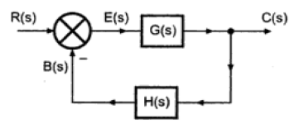
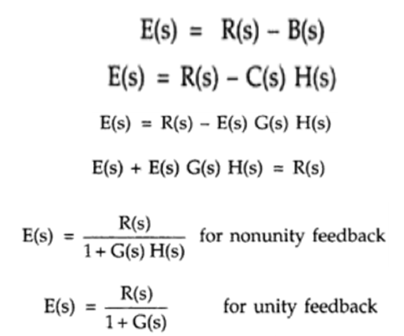

Slide 9



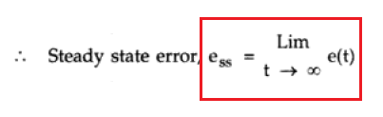

Slide 10

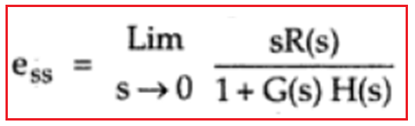
Derivation of Steady-State Error

Slide 11
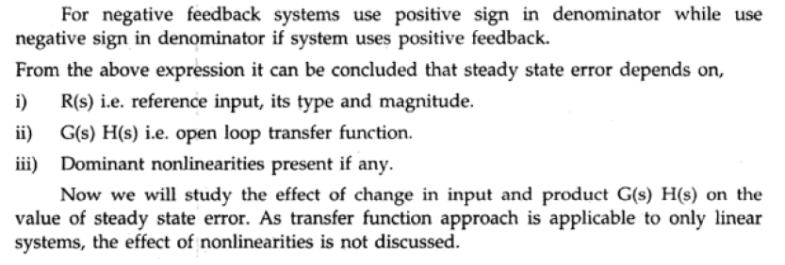
Derivation of Steady-State Error

Slide 12
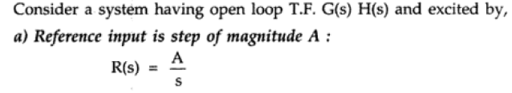
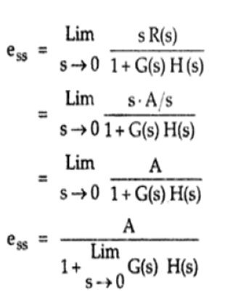
Effect of Input on Steady-State Error

Slide 13
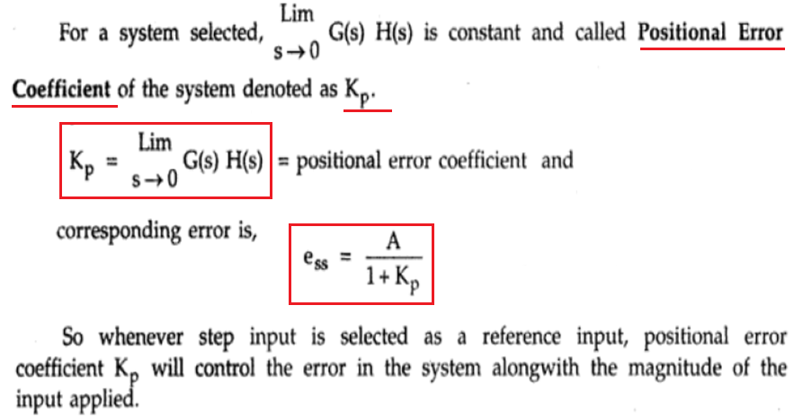
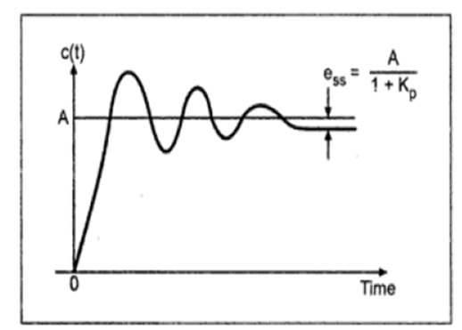
Effect of Input on Steady-State Error

Slide 14
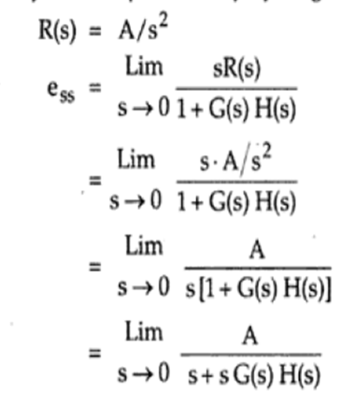
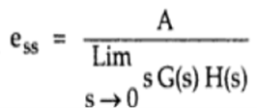
Effect of Input on Steady-State Error

Slide 15
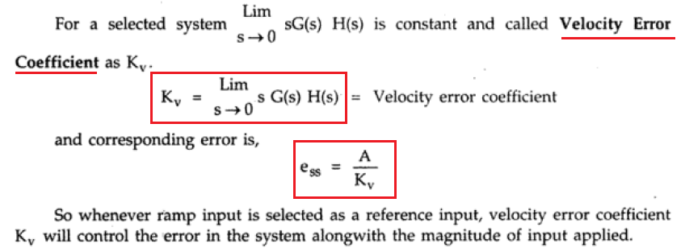
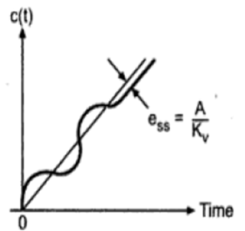
Effect of Input on Steady-State Error

Slide 16
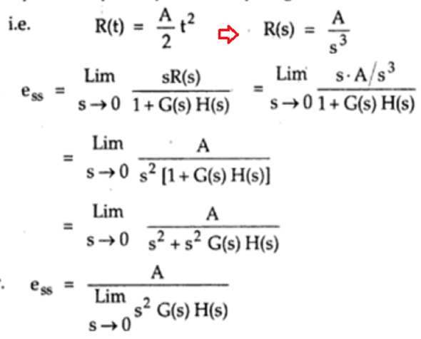
Effect of Input on Steady-State Error

Slide 17
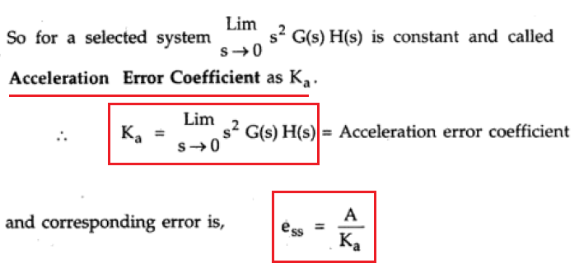
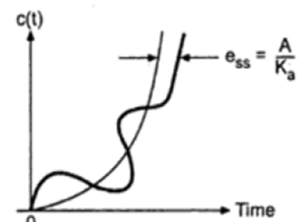

Effect of Input on Steady-State Error

Slide 18
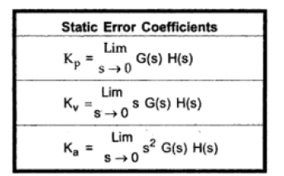
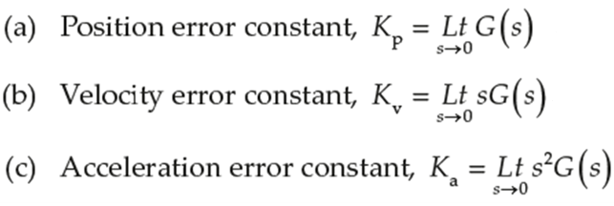
Static Error Coefficients

Slide 19
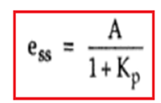
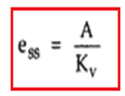
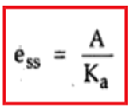
Steady state Error
TYPE 0 TYPE 1 TYPE 2

Slide 20
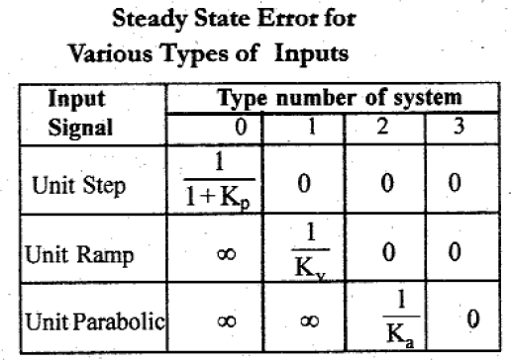
Summary

Slide 21
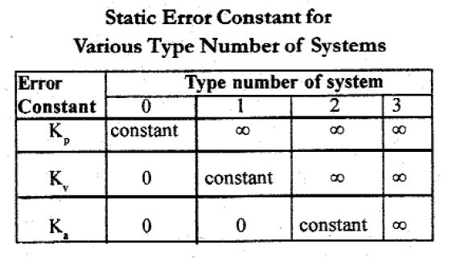
Summary

Slide 22
Steady state error- problems

Slide 23

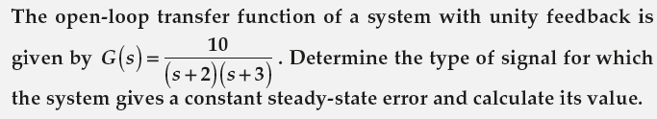


Problems in SEC, GES & GEC

Slide 24

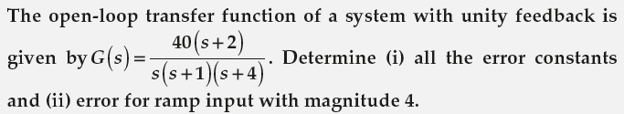

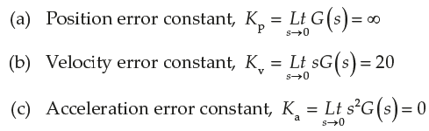
Problems in SEC, GES & GEC

Slide 25


Problems in SEC, GES & GEC

Slide 26

Thank you

Slide 27

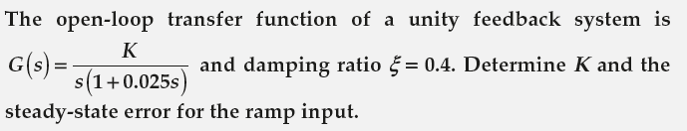

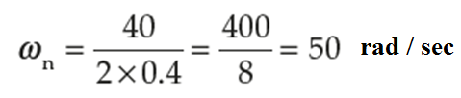

Problems in SEC, GES & GEC

Slide 28
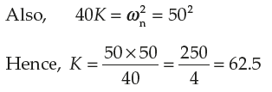
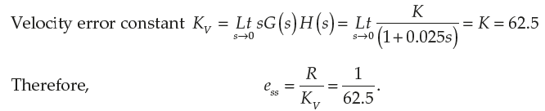
Problems in SEC, GES & GEC

